Slide 1
Foundations of Planning
Management
Stephen P. Robbins Mary Coulter
tenth edition
Chapter
7
7–<number>
Copyright © 2010 Pearson Education, Inc. Publishing as Prentice Hall

Slide 2
Learning Outcomes
Follow this Learning Outline as you read and study this chapter.
7.1 The What And Why Of Planning
  Define planning.
  Describe the purposes of planning.
  Explain what studies have shown about the relationship between planning and performance.
7.2 Goals And Plans
  Define goals and plans.
  Describe the types of goals organizations might have.
  Describe each of the different types of plans.
7–<number>
Copyright © 2010 Pearson Education, Inc. Publishing as Prentice Hall

Slide 3
Learning Outcomes
7.3 Setting Goals and Developing Plans
  Discuss how traditional goal setting and MBO work.
  Describe well written goals and explain hw to set them.
  Discuss the contingency factors that affect planning.
  Describe the approaches to planning.
7.4 Contemporary Issues in Planning
  Explain the criticisms of planning.
  Describe how managers can effectively plan in today’s dynamic environment.
7–<number>
Copyright © 2010 Pearson Education, Inc. Publishing as Prentice Hall

Slide 4
What Is Planning?
Planning
  A primary managerial activity that involves:
    Defining the organization’s goals
    Establishing an overall strategy for achieving those goals
    Developing plans for organizational work activities
  Formal planning
    Specific goals covering a specific time period
    Written and shared with organizational members
7–<number>
Copyright © 2010 Pearson Education, Inc. Publishing as Prentice Hall

Slide 5

Why Do Managers Plan?
Purposes of Planning
  Provides direction
  Reduces uncertainty
  Minimizes waste and redundancy
  Sets the standards for controlling
7–<number>
Copyright © 2010 Pearson Education, Inc. Publishing as Prentice Hall

Slide 6
Planning and Performance
The Relationship Between Planning and Performance
  Formal planning is associated with:
    Higher profits and returns on assets.
    Positive financial results.
  The quality of planning and implementation affects performance more than the extent of planning.
  The external environment can reduce the impact of planning on performance.
  Formal planning must be used for several years before planning begins to affect performance.
7–<number>
Copyright © 2010 Pearson Education, Inc. Publishing as Prentice Hall

Slide 7
How Do Managers Plan?
Elements of Planning
  Goals (also Objectives)
    Desired outcomes for individuals, groups, or entire organizations
    Provide direction and evaluation performance criteria
  Plans
    Documents that outline how goals are to be accomplished
    Describe how resources are to be allocated and establish activity schedules
7–<number>
Copyright © 2010 Pearson Education, Inc. Publishing as Prentice Hall

Slide 8
Types of Goals
Financial Goals
  Are related to the expected internal financial performance of the organization.
Strategic Goals
  Are related to the performance of the firm relative to factors in its external environment (e.g., competitors).
Stated Goals versus Real Goals
  Broadly-worded official statements of the organization (intended for public consumption) that may be irrelevant to its real goals (what actually goes on in the organization).
7–<number>
Copyright © 2010 Pearson Education, Inc. Publishing as Prentice Hall

Slide 9
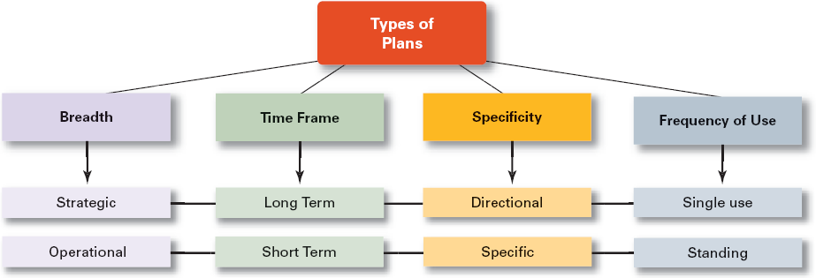
Exhibit 7–1 Types of Plans
7–<number>
Copyright © 2010 Pearson Education, Inc. Publishing as Prentice Hall

Slide 10
Types of Plans
Strategic Plans
  Apply to the entire organization.
  Establish the organization’s overall goals.
  Seek to position the organization in terms of its environment.
  Cover extended periods of time.
Operational Plans
  Specify the details of how the overall goals are to be achieved.
  Cover a short time period.
7–<number>
Copyright © 2010 Pearson Education, Inc. Publishing as Prentice Hall

Slide 11
Types of Plans
Long-Term Plans
  Plans with time frames extending beyond three years
Short-Term Plans
  Plans with time frames of one year or less
Specific Plans
  Plans that are clearly defined and leave no room for interpretation
Directional Plans
  Flexible plans that set out general guidelines and provide focus, yet allow discretion in implementation
7–<number>
Copyright © 2010 Pearson Education, Inc. Publishing as Prentice Hall

Slide 12
Types of Plans
Single-Use Plan
  A one-time plan specifically designed to meet the need of a unique situation.
Standing Plans
  Ongoing plans that provide guidance for activities performed repeatedly.
7–<number>
Copyright © 2010 Pearson Education, Inc. Publishing as Prentice Hall

Slide 13
Setting Goals and Developing Plans
Traditional Goal Setting
  Broad goals are set at the top of the organization.
  Goals are then broken into sub-goals for each organizational level.
  Assumes that top management knows best because they can see the “big picture.”
  Goals are intended to direct, guide, and constrain from above.
  Goals lose clarity and focus as lower-level managers attempt to interpret and define the goals for their areas of responsibility.
7–<number>
Copyright © 2010 Pearson Education, Inc. Publishing as Prentice Hall

Slide 14
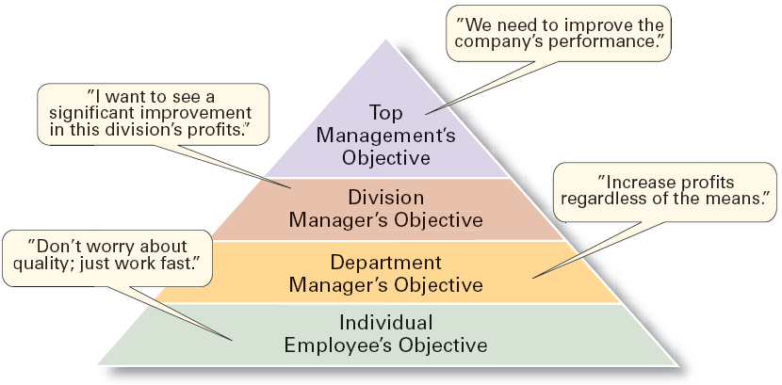
Exhibit 7–2 The Downside of Traditional Goal Setting
7–<number>
Copyright © 2010 Pearson Education, Inc. Publishing as Prentice Hall

Slide 15
Setting Goals and Developing Plans
Maintaining the Hierarchy of Goals
  Means–Ends Chain
    The integrated network of goals that results from establishing a clearly-defined hierarchy of organizational goals.
    Achievement of lower-level goals is the means by which to reach higher-level goals (ends).
7–<number>
Copyright © 2010 Pearson Education, Inc. Publishing as Prentice Hall

Slide 16
Setting Goals and Developing Plans
Management By Objectives (MBO)
  Specific performance goals are jointly determined by employees and managers.
  Progress toward accomplishing goals is periodically reviewed.
  Rewards are allocated on the basis of progress towards the goals.
  Key elements of MBO:
    Goal specificity, participative decision making, an explicit performance/evaluation period, feedback
7–<number>
Copyright © 2010 Pearson Education, Inc. Publishing as Prentice Hall

Slide 17
Exhibit 7–3 Steps in a Typical MBO Program
The organization’s overall objectives and strategies are formulated.
Major objectives are allocated among divisional and departmental units.
Unit managers collaboratively set specific objectives for their units with their managers.
Specific objectives are collaboratively set with all department members.
Action plans, defining how objectives are to be achieved, are specified and agreed upon by managers and employees.
The action plans are implemented.
Progress toward objectives is periodically reviewed, and feedback is provided.
Successful achievement of objectives is reinforced by performance-based rewards.
7–<number>
Copyright © 2010 Pearson Education, Inc. Publishing as Prentice Hall

Slide 18
Does MBO Work?
Reason for MBO Success
  Top management commitment and involvement
Potential Problems with MBO Programs
  Not as effective in dynamic environments that require constant resetting of goals.
  Overemphasis on individual accomplishment may create problems with teamwork.
  Allowing the MBO program to become an annual paperwork shuffle.
7–<number>
Copyright © 2010 Pearson Education, Inc. Publishing as Prentice Hall

Slide 19
Exhibit 7–4 Well-Written Goals
Written in terms of outcomes, not actions
  Focuses on the ends, not the means.
Measurable and quantifiable
  Specifically defines how the outcome is to be measured and how much is expected.
Clear as to time frame
  How long before measuring accomplishment.
Challenging yet attainable
  Low goals do not motivate.
  High goals motivate if they can be achieved.
Written down
  Focuses, defines, and makes goals visible.
Communicated to all necessary organizational members
  Puts everybody “on the same page.”
7–<number>
Copyright © 2010 Pearson Education, Inc. Publishing as Prentice Hall

Slide 20
Steps in Goal Setting
Review the organization’s mission statement.
  Do goals reflect the mission?
Evaluate available resources.
  Are resources sufficient to accomplish the mission?
Determine goals individually or with others.
  Are goals specific, measurable, and timely?
Write down the goals and communicate them.
  Is everybody on the same page?
Review results and whether goals are being met.
  What changes are needed in mission, resources, or goals?
7–<number>
Copyright © 2010 Pearson Education, Inc. Publishing as Prentice Hall

Slide 21
Developing Plans
Contingency Factors in a Manager’s Planning
  Manager’s level in the organization
    Strategic plans at higher levels
    Operational plans at lower levels
  Degree of environmental uncertainty
    Stable environment: specific plans
    Dynamic environment: specific but flexible plans
  Length of future commitments
    Commitment Concept: current plans affecting future commitments must be sufficiently long-term to meet those commitments.
7–<number>
Copyright © 2010 Pearson Education, Inc. Publishing as Prentice Hall

Slide 22
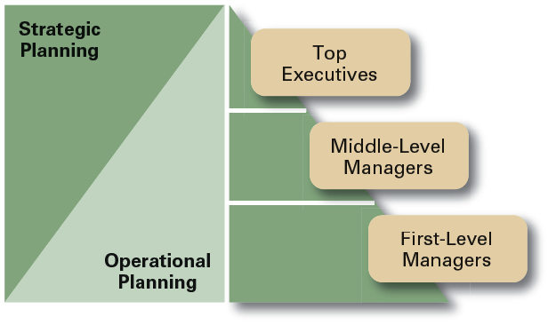
Exhibit 7–5 Planning in the Hierarchy of
Organizations
7–<number>
Copyright © 2010 Pearson Education, Inc. Publishing as Prentice Hall

Slide 23
Approaches to Planning
Establishing a formal planning department
  A group of planning specialists who help managers write organizational plans.
  Planning is a function of management; it should never become the sole responsibility of planners.
Involving organizational members in the process
  Plans are developed by members of organizational units at various levels and then coordinated with other units across the organization.
7–<number>
Copyright © 2010 Pearson Education, Inc. Publishing as Prentice Hall

Slide 24
Contemporary Issues in Planning
Criticisms of Planning
  Planning may create rigidity.
  Plans cannot be developed for dynamic environments.
  Formal plans cannot replace intuition and creativity.
  Planning focuses managers’ attention on today’s competition not tomorrow’s survival.
  Formal planning reinforces today’s success, which may lead to tomorrow’s failure.
  Just planning isn’t enough.
7–<number>
Copyright © 2010 Pearson Education, Inc. Publishing as Prentice Hall

Slide 25
Contemporary Issues in Planning (cont’d)
Effective Planning in Dynamic Environments
  Develop plans that are specific but flexible.
  Understand that planning is an ongoing process.
  Change plans when conditions warrant.
  Persistence in planning eventually pay off.
  Flatten the organizational hierarchy to foster the development of planning skills at all organizational levels.
7–<number>
Copyright © 2010 Pearson Education, Inc. Publishing as Prentice Hall

Slide 26
Terms to Know
planning
goals
plans
stated goals
real goals
framing
strategic plans
operational plans
long-term plans
short-term plans
specific plans
directional plans
single-use plan
standing plans
traditional goal setting
means-ends chain
management by objectives (MBO)
mission
commitment concept
formal planning department
7–<number>
Copyright © 2010 Pearson Education, Inc. Publishing as Prentice Hall

Slide 27

All rights reserved. No part of this publication may be reproduced, stored in a retrieval system, or transmitted, in any form or by any means, electronic, mechanical, photocopying, recording, or otherwise, without the prior written permission of the publisher. Printed in the United States of America.
7–<number>
Copyright © 2010 Pearson Education, Inc. Publishing as Prentice Hall

